Slide 1
Higher National Diploma (HND)
Digital Technologies
Unit 20: Internet of Things
Week 4: Lecture 1

Slide 2
Recap
Last week, we explored core components of IoT such as:
Evaluated IoT Hardware.
Applied Hardware Knowledge.
Analysed IoT Software
Explored Software Examples
Understood IoT Cloud & APIs.
Assessed Cloud Service Models and key service providers.
Selected Appropriate APIs

Slide 3

Recap
In last week’s submitted formative, we

Slide 4
SESSION AIM AND OUTCOMES
**AIM**
To enable students to critically analyse real-world issues and design effective IoT solutions to address them
By the end of this class, students will be able to:
Analyse and evaluate two issues that can be addressed using IoT solutions.
Design and propose IoT solutions to effectively tackle these issues.
Identify, select and justify appropriate IoT architecture, tools, hardware, software, and APIs for implementing the proposed solutions

Slide 5
RELATED ASSESSMENT LEARNING OUTCOMES AND CRITERIA
LO1: Analyse what aspects of IoT are necessary and appropriate when designing software applications.
M2
LO2: Outline a plan for an appropriate IoT application using common architecture, frameworks, tools, hardware, and APIs..
M3

Slide 6
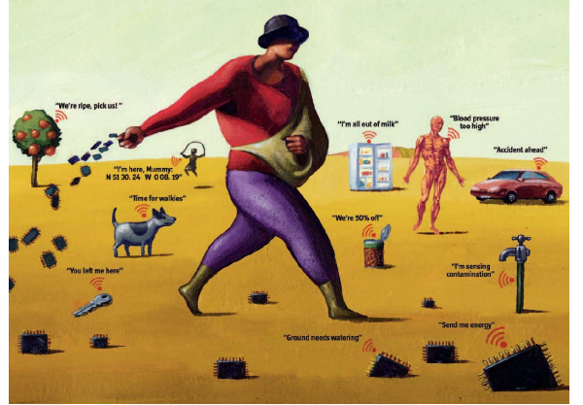

A VIVID DESCRIPTION OF THE VISION OF INTERNET-OF-THINGS (IoT)
Class Activity
Task:
In what ways could IoT be applied in the context of this image?
Notes:
All the “things” in the picture have a form of connectivity. They are helping to solve different problems.

Slide 7
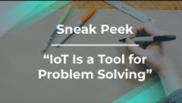
TAKE YOUR TIME TO WATCH THIS VIDEO
Key point:
The key point to take from watching the video is that IoT can be consider a solution for solving problems.
(Product School, 2018)

Slide 8
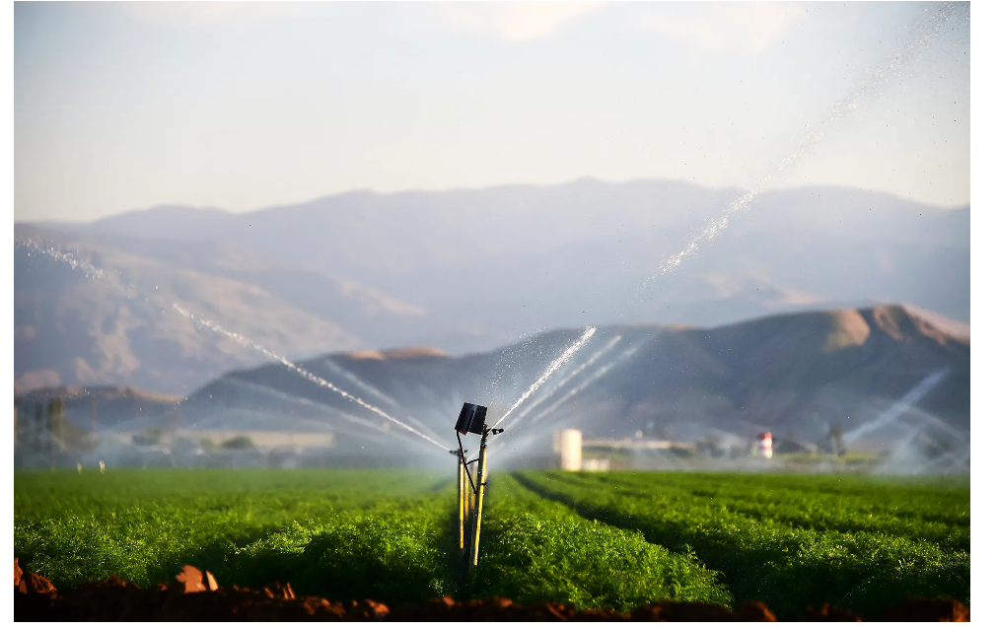
REAL-LIFE PROBLEM THAT CAN BE SOLVED WITH IoT
Issue 1
How do we water crops on a farm when the farmer cannot make it to the farm?
For example, when he is sick or out of town
(Wolfert et al., 2017; Tzounis et al., 2017)

Slide 9
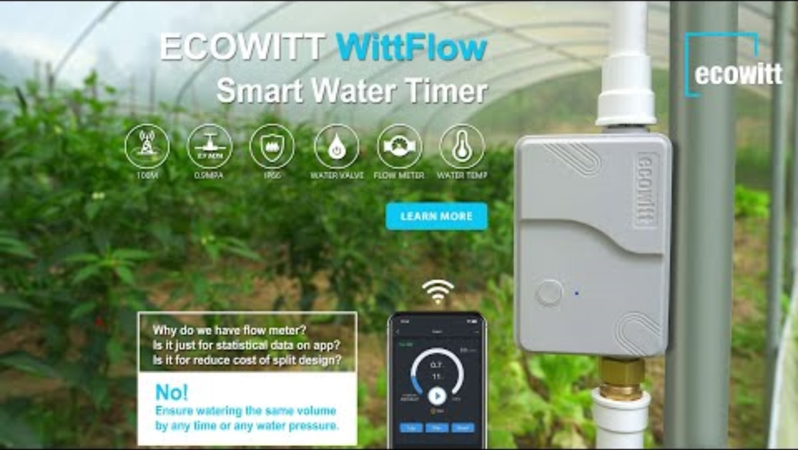
IoT DOMAIN AND USE CASE
•Issue one falls under the smart agriculture domain
(Wolfert et al., 2017)
•The use case falls under soil monitoring and irrigation system
(Patil and Singh, 2020)
Notes:
The rural part of most developing countries does not fulfill this requirement. Moreover, the internet connection is slower

Slide 10
SMART AGRICULTURE DOMAIN
Advantages of Smart Agriculture:
1.) Maximise yields while minimizing resources use(water, fertilizers, seeds, etc.)
2.) Enable wireless monitoring and control of farm operations.
Disadvantages of Smart Agriculture:
1.) Requires continuous internet availability, which may be lacking in rural areas of many developing countries.
2.) Farmers need to learn and adapt to technology, as smart farming equipment can be complex
(RF Wireless World, n.d)
Notes:
The rural part of most developing countries does not fulfill this requirement. Moreover, the internet connection is slower

Slide 11
WHAT CAN BE ACHIEVED?
Automated watering of crops on the farm
Time-saving
Save water resources
Smart Agriculture
Reduces manual labour and operational costs
Improve crop yield by maintaining optimal soil conditions
(Tzounis et al., 2017)

Slide 12



CLASS ACTIVITY 1
Task
Form a group of four to:
Outline and discuss how the application of IoT will help to address issue one
Propose relevant IoT components for the proposed solution(Architecture, hardware, software, connectivity and API techniques)

Slide 13
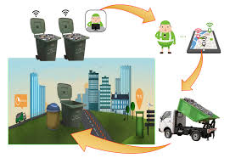
REAL-LIFE PROBLEM THAT CAN BE SOLVED WITH IoT Continued
Issue 2
How do we make a dirty
community clean by enabling
the residents to dispose their
rubbish correctly?
(Smartworld,2023)

Slide 14
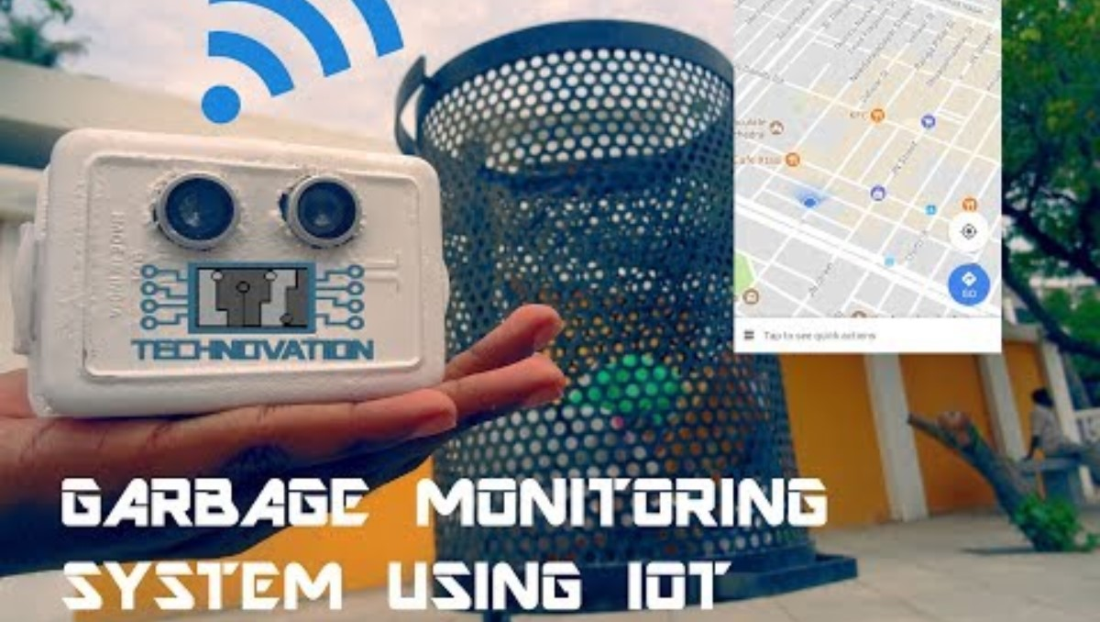
IoT DOMAIN AND USE CASE FOR ISSUE TWO
•Issue falls under Smart City
(Ahmad et al., 2021)
•The use case falls under Smart Waste Management
(Shah et al., 2022)

Slide 15
SMART WASTE MANAGEMENT SYSTEM
Advantages of Smart Waste Management:
Saves time and money by using smart waste collection bins and systems.
Reduces traffic and air pollution, leading to lower noise levels due to fewer waste collection vehicles on the roads.
Disadvantages of Smart Waste Management:
High initial costs because smart bins are more expensive than traditional methods.
Reduces manpower requirements, which may lead to increased unemployment.
(NETMOW, 2025)
Notes:
15

Slide 16
WHAT CAN BE ACHIEVED…?
Clean environment
Time and resources saving
People in the community can use a smart bin that automatically opens and closes
Bin can also pass useful information to the bin collectors
Smart city
(Shah et al., 2022)

Slide 17
CLASS ACTIVITY 2
Task
Form a group of four to:
Outline and discuss how the application of IoT will help to address issue two.
Propose relevant IoT components for the proposed solution(Architecture, hardware, software, connectivity and API techniques)

Slide 18
SUMMARY​
In today's lesson, we have :
Looked at real-life problems that can be solved with IoT
Explored how these real-life problems can be solved using appropriate architecture, tools, hardware, and API techniques
We conclude that IoT can solve some of the problems we face in our current society.

Slide 19
REFERENCES
Finley, K, 2015. A Smart Sensor to Help Farmers Save Water in a Drought [online]. Available at https://www.wired.com/2015/06/smart-sensor-farmers-dont-waste-water-drought/ (Accessed 22nd April 2023).
Kumar, V., Sharma, K.V., Kedam, N., Patel, A., Kate, T.R. and Rathnayake, U., 2024. A comprehensive review on smart and sustainable agriculture using IoT technologies Smart Agricultural Technology Approach [Online]. Available at A comprehensive review on smart and sustainable agriculture using IoT technologies (Accessed 22nd April 2023).
McEwen, A. (2013) Designing the Internet of Things. 1st Ed. John Wiley and Sons.
NETMOW, 2025. Top 10 Key Advantages of Smart Dustbins in Waste Management EXCEED ICT [Online]. Available at Top 10 Key Advantages of Smart Dustbins in Waste Management (Accessed 22nd April 2023).
Patil, K. and Singh, N. (2020) ‘IoT based smart irrigation system using soil moisture sensor’, International Journal of Advanced Research in Computer and Communication Engineering, 9(3), pp. 12–15.
Pawar, P., Ambigar, S.N.,Rangeneni, N. and Kran, D., 2021. Smart Waste Management System Based On A IoT Platform [Online]. Available at https://extrudesign.com/smart-waste-management-system-based-on-a-iot-platform/ (Accessed 22nd April 2023).
Product School (2018) Sneak Peek: IoT is a Tool for Problem Solving by IoT Product Leader [YouTube video]. Available at: https://www.youtube.com/watch?v=kxW5qY4bFuo (Accessed: 22 April 2023).

Slide 20
REFERENCES Continued..
RF Wireless World, n.d. Advantages of Smart Agriculture | disadvantages of Smart Agriculture [Online]. Available at Advantages of Smart Agriculture | disadvantages of Smart Agriculture (Accessed 22nd April 2023).
Shah, M.A., Shehzad, M., Wahid, A., Tahir, M. and Ullah, S. (2022) ‘IoT-based smart waste management system for smart cities: A survey’, Sustainable Cities and Society, 76, p. 103383.
Smart Farming: How Robots and AI Can Help Us with Farming | Farming Technology, 2022. YouTube video, added by DW Shift [Online]. Available at Smart Farming: How Robots and AI Can Help Us with Farming | Farming Technology (24th November 2023)
Smart Garbage Monitoring System using Internet of Things (IOT), 2018. YouTube video, added by Technovation Projects [Online]. Available at Smart Garbage Monitoring System using Internet of Things (IOT)(24th November 2023)
Smart Waste Management using IoT, 2019. YouTube video, added by Sensoneo Smart Waste Management[Online]. Available at Smart Waste Management using IoT (24th November 2023)
Smartworld,2023. Smart Bin Sensors [online]. Available at https://smartworlds.in/solid-waste-management-solution/smart-bin-sensors/ (Accessed 22nd April 2023).

Slide 21
REFERENCES Continued…
Srinivas, M., Benedict, S. and Sunny, B.C., 2019. IoT Cloud based Smart Bin for Connected Smart Cities - A Product Design Approach [Online]. Available at https://www.researchgate.net/publication/338365767_IoT_Cloud_based_Smart_Bin_for_Connected_Smart_Cities_-_A_Product_Design_Approach(Accessed 22nd April 2023).
Tzounis, A., Katsoulas, N., Bartzanas, T. and Kittas, C. (2017) ‘Internet of Things in agriculture, recent advances and future challenges’, Biosystems Engineering, 164, pp. 31–48.
Wolfert, S., Ge, L., Verdouw, C. and Bogaardt, M.J. (2017) ‘Big Data in Smart Farming – A review’, Agricultural Systems, 153, pp. 69–80

Slide 22

QUESTIONS

Slide 23
Higher National Diploma (HND)
Digital Technologies
Unit 20: Internet of Things
Week 4: Lecture 2

Slide 24
Recap from Previous Session
In our previous session, we explored how IoT technologies can be applied to solve real-world problems.
We examined practical use cases and developed tailored solutions
Here's a quick recap of what we covered:
Analysed and evaluated two real-world problems that can be addressed using IoT technologies
Designed and proposed effective IoT-based solutions tailored to each issue
Identified, selected, and justified suitable IoT architectures, tools, hardware components, software platforms, and APIs required to implement the proposed solutions

Slide 25
Session Aim and Outcomes
Aim
To enable students to analyse and design IoT solutions by examining problem-solving requirements and developing comprehensive implementation plans
By the end of this class, students will be able to:
Describe problem-solving requirements in IoT design
Identify, determine and prioritise relevant requirements for specific IoT design
Evaluate how NB-IoT and eLTE IoT solutions address specific requirements
Design and propose a comprehensive plan for developing and implementing IoT solutions

Slide 26
IoT Problem-solving Requirements
IoT systems must be designed with the problem requirements in mind
These requirements forms the foundational aspects needed for effective IoT design and implementation
They ensure IoT applications address specific challenges
They ensure IoT application function reliably and securely
Meeting key problem-solving requirements is essential for successful IoT deployment
(Olivia, n.d).

Slide 27
Some of the Key Problem-Solving
Requirements In IoT Design
Latency and Bandwidth
Network Coverage/Connectivity
Data/Event Collection & Transmission
Reliability and Performance metrics
Cost, Power/Energy Management
Security, Environment & Operating Requirements
(Akpakwu et al., 2017)

Slide 28


CLASS ACTIVITY
Discuss the IoT problem-solving requirements relating to creating a smart bin for your assignment.
Prioritise the relevant requirements based on the user needs, as you understand them
Notes:
Possible answers:
vSensors to monitor movement and the fill level
vReliable communication between the smart bin, platform and bin collectors/council
vLow-power operation for long-lasting battery life or solar-powered systems
vReal-time data analytics to optimise waste collection routes and schedules
vRobust design to withstand weather conditions, fire, vandalism, and heavy usage
vAbility to integrate multiple bins into a city-wide or facility-wide smart waste management system
vSecure communication and data protection
vIntuitive interfaces for users and maintenance teams
vAffordable implementation and maintenance

Slide 29
Key Technologies That Support Mobile/Cellular Communications for IoT Applications
1G- Early versions based on several systems and standards
2G- Second-generation developed to meet the problem of several standards
3G- Third-generation addresses high demand for high-speed networks
4G- Fourth-generation offers much faster speed.
5G- The fifth-generation provides optimal transmission technology for every application
(TELENOR CONNEXION, 2020)

Slide 30
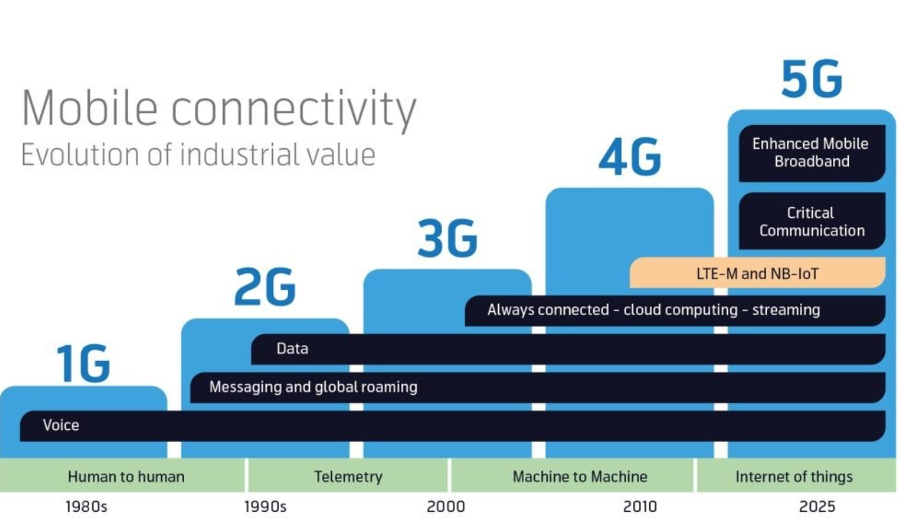
Mobile Connectivity
TELENOR CONNEXION, 2020

Slide 31
KEY TECHNOLOGIES FOR MOBILE COMMUNICATIONS DESIGNED FOR IOT USE
eLTE (Enhanced Long-Term Evolution):
Cellular solution introduced by Huawei
Provides extensive area coverage in alignment with Long-Term Evolution (LTE) standards
NB-IoT (Narrowband Internet of Things)
Cellular technology introduced in 3GPP Release 13
Offers wide-area IoT coverage
Both technologies have been deployed in various commercial applications across multiple industries
(Deutsche Telekom AG, 2019; Shakeela, 2024)

Slide 32
NB-IOT AND ELTE-IOT SOLUTIONS
Both NB-IoT and eLTE-IoT address connectivity problems in hard-to-reach locations
NB-IoT solutions:
Revolutionise cities and businesses that rely data access in hard-to-reach places
For example, remote rural environment, Offshore or coastal areas etc.
eLTE-IoT solutions:
Revolutionise cities and businesses that rely on access to data in hard-to-reach locations
For example, underground layers, disaster or emergency zones etc
(Ukovich, A., 2022; IoTNow, 2021)

Slide 33
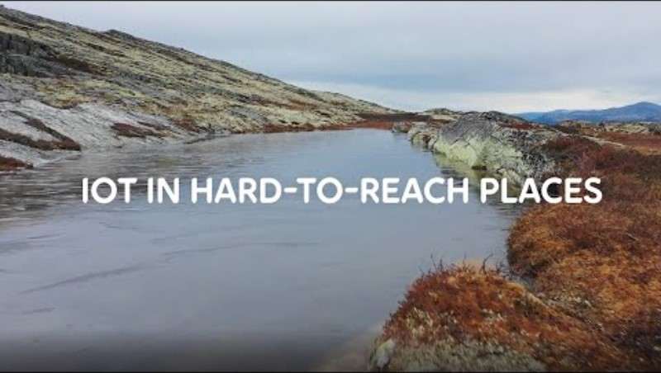
PLEASE WATCH THIS VIDEO
(Telia Company, 2022)

Slide 34
FEATURES AND PROBLEM-SOLVING REQUIREMENTS TACKLED BY NB-IOT SOLUTION
Low power wireless wide area network (LPWAN) technology
Mass distributed static devices
Transmit small data amounts and requires low power
Wide area coverage, usually slower speed
Reach deep indoor and underground areas
Cheaper: no gateway needed
(Ukovich, A., 2022)

Slide 35
FEATURES AND PROBLEM-SOLVING REQUIREMENTS TACKLED BY ELTE-IOT SOLUTION
Wireless private narrowband IoT solution for industrial IoT markets
Mass distributed lightweight devices (static and mobile)
Transmit medium data amounts and requires low power
Wide area coverage, usually slower speed
Reach deep indoor and underground areas
Cheaper: no gateway needed but more costly than NB-IoT
Support voice and video
(IoTNow, 2021)

Slide 36

CLASS ACTIVITY 2
Scenario
Your organisation will be involved in an IoT
The IoT project
Energy meters that would be installed in basements without electricity. The meter is expected to send small amounts of data at long interval and must be cost effective.
Questions
What are the problem-solving requirements for the project? Would you recommend an upgrade to IoT-specific solutions NB-IoT or eLTE-IoT? Why?
Post your answer in the Class Discussion Forum in Moodle

Slide 37
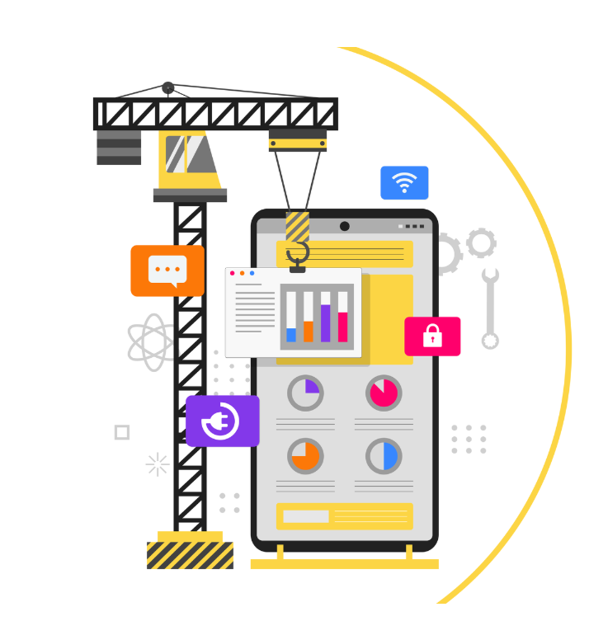
Planning an IoT Application to Solve Problems
  •Understanding real-life problems and identifying their requirements are essential for creating effective IoT solutions
  •A structured development plan also facilitates smoother implementation
  •Planning for the development of an IoT application involves several key steps
  We will explore each of these steps in the following slides
  (Abdulaziz, 2025; Lee, and Brynjolfsson, 2020; Lawal, et al., 2022).

Slide 38
Planning for an IoT Application to Solve Problems
1. Understand the users who will interact with the system
2. Define and understand the problem
3. Describe the implementation
Goals and objectives
Use cases and domain
Core functionalities
4. Prototype!
5. Test
- Return to step 1 as needed

Slide 39
Every prototype needs…
 | Role | Implementation | Look and Feel
Your prototype needs: | Something it is doing in the users’ lives | Architecture, sensors, data management, security… | A physical appearance
You need: | A means of testing the application in various settings and with various people | A technical awareness of how to build and improve your application | To visualize your application in different contexts and in different ways
hardware (devices and sensors) that you will require for your implementation
Select an appropriate connectivity option
Houde and Hill, 1997

Slide 40
Week 4 – GenAI playground
Prompt an LLM to evaluate IoT components for solving a problem and meeting the problem's requirement
Give the LLM an engineering problem that could be solved by an IT device
Ask it to recommend a sensor that you can include in an application to solve the problem
Sample problem: We need to automatically open a door in a factory when humans approach it. However, the door must not open when other objects approach, such as wind-blown rubbish or when objects are placed near the door (e.g., boxes, vehicles, etc.) (Feel free to ask a different problem if you can think of one)
Post your results in the forum on Moodle. Why do you think the AI recommended the sensor it did? Can you think of a simpler solution?

Slide 41
SUMMARY​
In today's lesson, we have :
Looked at real life problems that can be solved with IoT
Explored how these real-life problem can be solved using appropriate architecture, tools, hardware, and API techniques
Discuss IoT problem-solving requirements
Discussed IoT application development plan
We conclude understanding IoT requirements and having a clear plan are essential for successful solution development and implementation

Slide 42
REFERENCES
Abdulaziz, Q.A., 2025. Validating an IoT implementation framework for supporting SME integration of Industry 4.0 technologies. Springer. Available at: https://link.springer.com [Accessed 8 September 2025].
Akpakwu, G.A., Silva, B., Hancke, G.P. and Abu-Mahfouz, A.M. (2017) ‘A survey on 5G networks for the Internet of Things: Communication technologies and challenges’, Sensors, 17(10), p. 2289. Available at: https://doi.org/10.3390/s17102289 [Accessed 22nd April 2023].
Arshdeep, B. (2014) Internet of Things: A Hands-on Approach. 1st Ed. VPT.
IoTNow, 2021. eLTE-IoT Network for Mexican Power Grid [online]. Available at https://www.iot-now.com/2021/10/05/114209-elte-iot-network-for-mexican-power-grid/ [Accessed 22nd April 2023]
Lawal, K., et al., 2022. Trends, benefits, risks, and challenges of IoT. Journal of Network and Computer Applications, ScienceDirect. Available at: https://www.sciencedirect.com [Accessed 22nd April 2023]
Lee, R. and Brynjolfsson, E., 2020. Realizing IoT’s potential: How to overcome challenges to enterprise implementation. MIT Sloan / MIT Technology Review. Available at: https://www.technologyreview.com [Accessed 22nd April 2023]
McEwen, A. (2013) Designing the Internet of Things. 1st Ed. John Wiley and Sons.
Olivia, n.d. IoT Projects 40 questions to map and identify your IoT requirements [Online]. Available at https://www.oliviawireless.com/guide-to-iot-projects/questions-to-define-requirements (Accessed 22nd April 2023).
Ukovich, A., 2022. NB-IoT Explained: What Is It, and How Does It Work? [online]. Available at https://www.telit.com/blog/nb-iot-new-cellular-standard-means-business/#:~:text=NB%2DIoT%20will%20revolutionize%20cities,Utility%20closets / (Accessed 22nd April 2023).

Slide 43
QUESTIONS

Slide 44
Higher National Diploma (HND)
Digital Technologies
Unit 20: Internet of things
Week 4, Lab

Slide 45
Session Aim and Outcomes
By the end of this class, students will be able to:
know the various components of the Uno kit
know Adruino Uno board
install the Arduino operating system (IDE).
prepare the Adruino Uno board to receive programs via USB cable

Slide 46
TASK
Go on Moodle and download the Lab notes 2.
Your lecturer will spend 45 minutes going through the lab notes with you.

Slide 47
Week 4 - Formative Activity
Develop a plan to solve the problem of residents throwing rubbish on the neighbourhood streets
Relate your plan to the problem described in the assignment scenario
Use the format you learned in class today to structure your plan (See slides 37 to 41).
Remember!
Please make sure you include your plan in your PowerPoint presentation for the final assessment.

Slide 48
REFERENCES
Vivekananda, S., 2023. INTERNET OF THINGS & ITS APPLICATIONS. [pdf]. Available at: https://mrcet.com/downloads/digital_notes/ME/III%20year/INTERNET%20OF%20THINGS%20&%20ITS%20APPLICATIONS.pdf [Accessed 20 December 2023].

Slide 49

Questions

